Slide 1

Unicorn Growth
Athena Wu
Ian Nguyen
Lana Huyen
Oty Baasandorj

Slide 2

Overview:
A PRIVATELY HELD STARTUP WITH VALUATION ABOVE 1 BILLION USD
Using the data of each unicorn company between 2022 and 2024, we will look at:
The relationship between growth and: Industry, year inducted as a Unicorn company, and location
Visualizations of the data
Analysis

Slide 3
INDUDSTRY 2022 GROWTH
Artificial Intelligence experienced the highest average growth rate, while the E-commerce & Direct-to-Consumer and Edtech industries saw significant declines.

Slide 4
INDUDSTRY 2023 GROWTH
Data Management & Analytics and Artificial Intelligence industries had notable growth, whereas the Internet and Supply Chain, Logistics, & Delivery industries experienced a decrease

Slide 5
INDUDSTRY TOTAL GROWTH
Artificial Intelligence and Other industries demonstrated the most substantial average total growth, highlighting their strong performance over the period, while the E-commerce & Direct-to-Consumer and Edtech industries underperformed

Slide 6
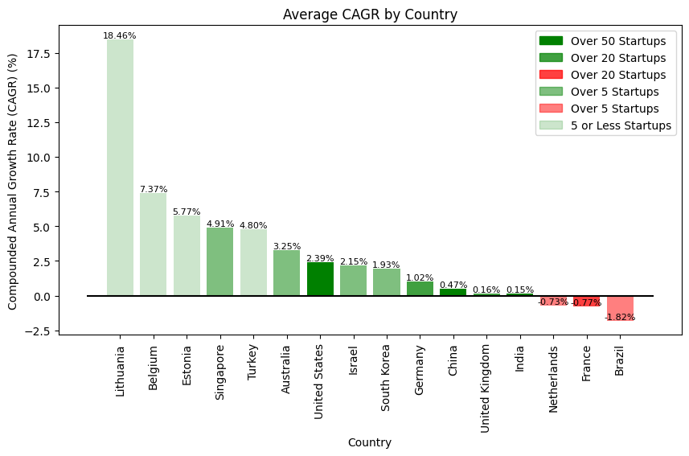

Slide 7
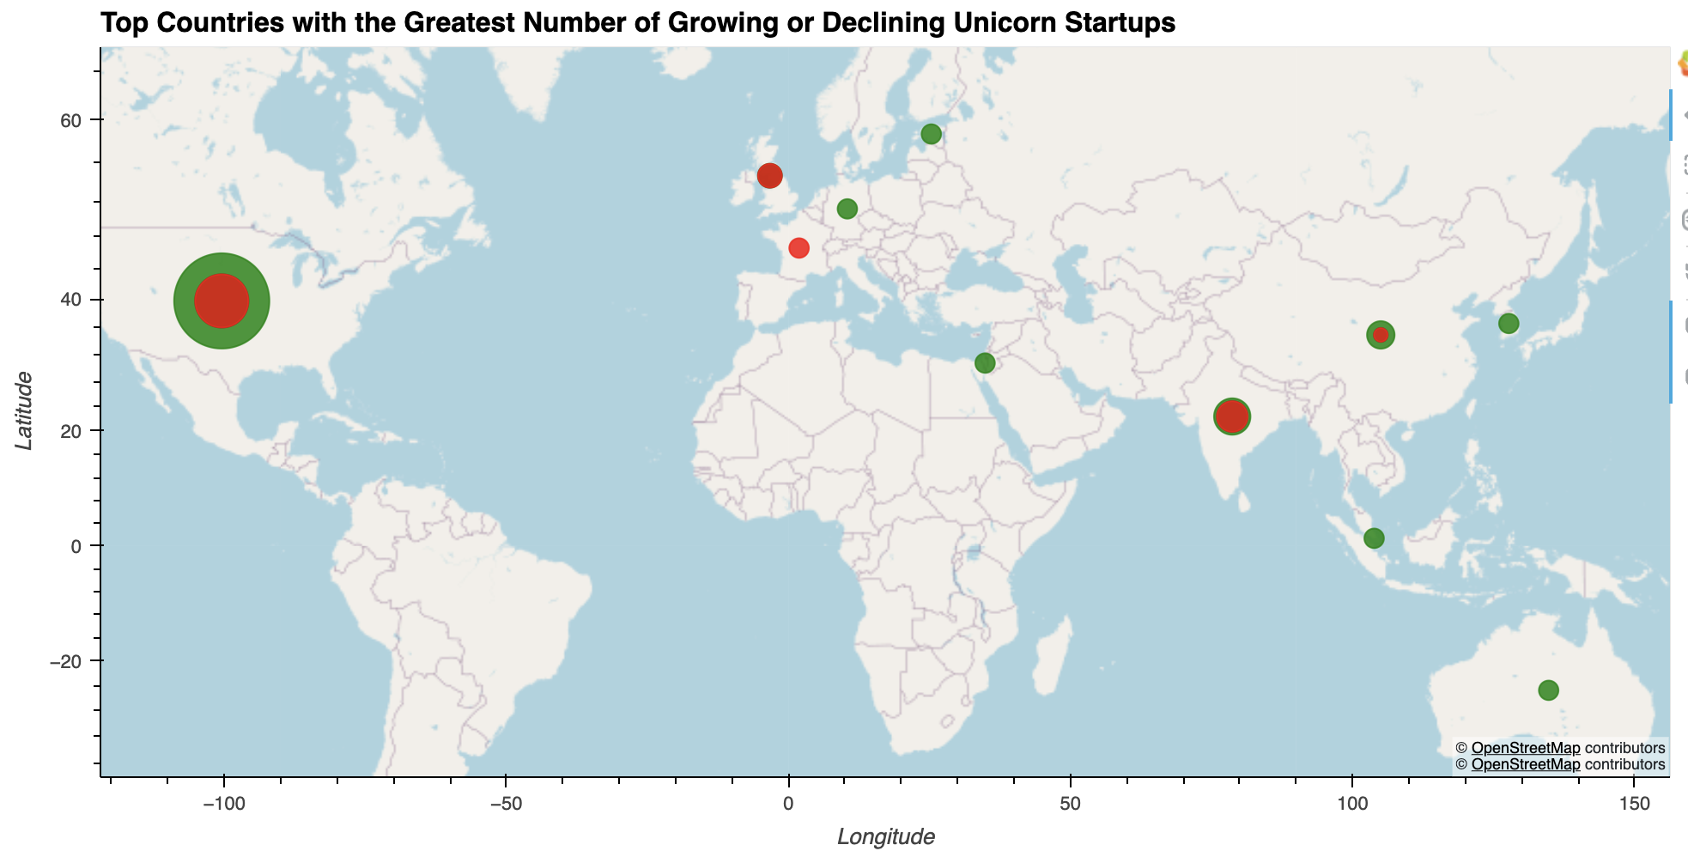
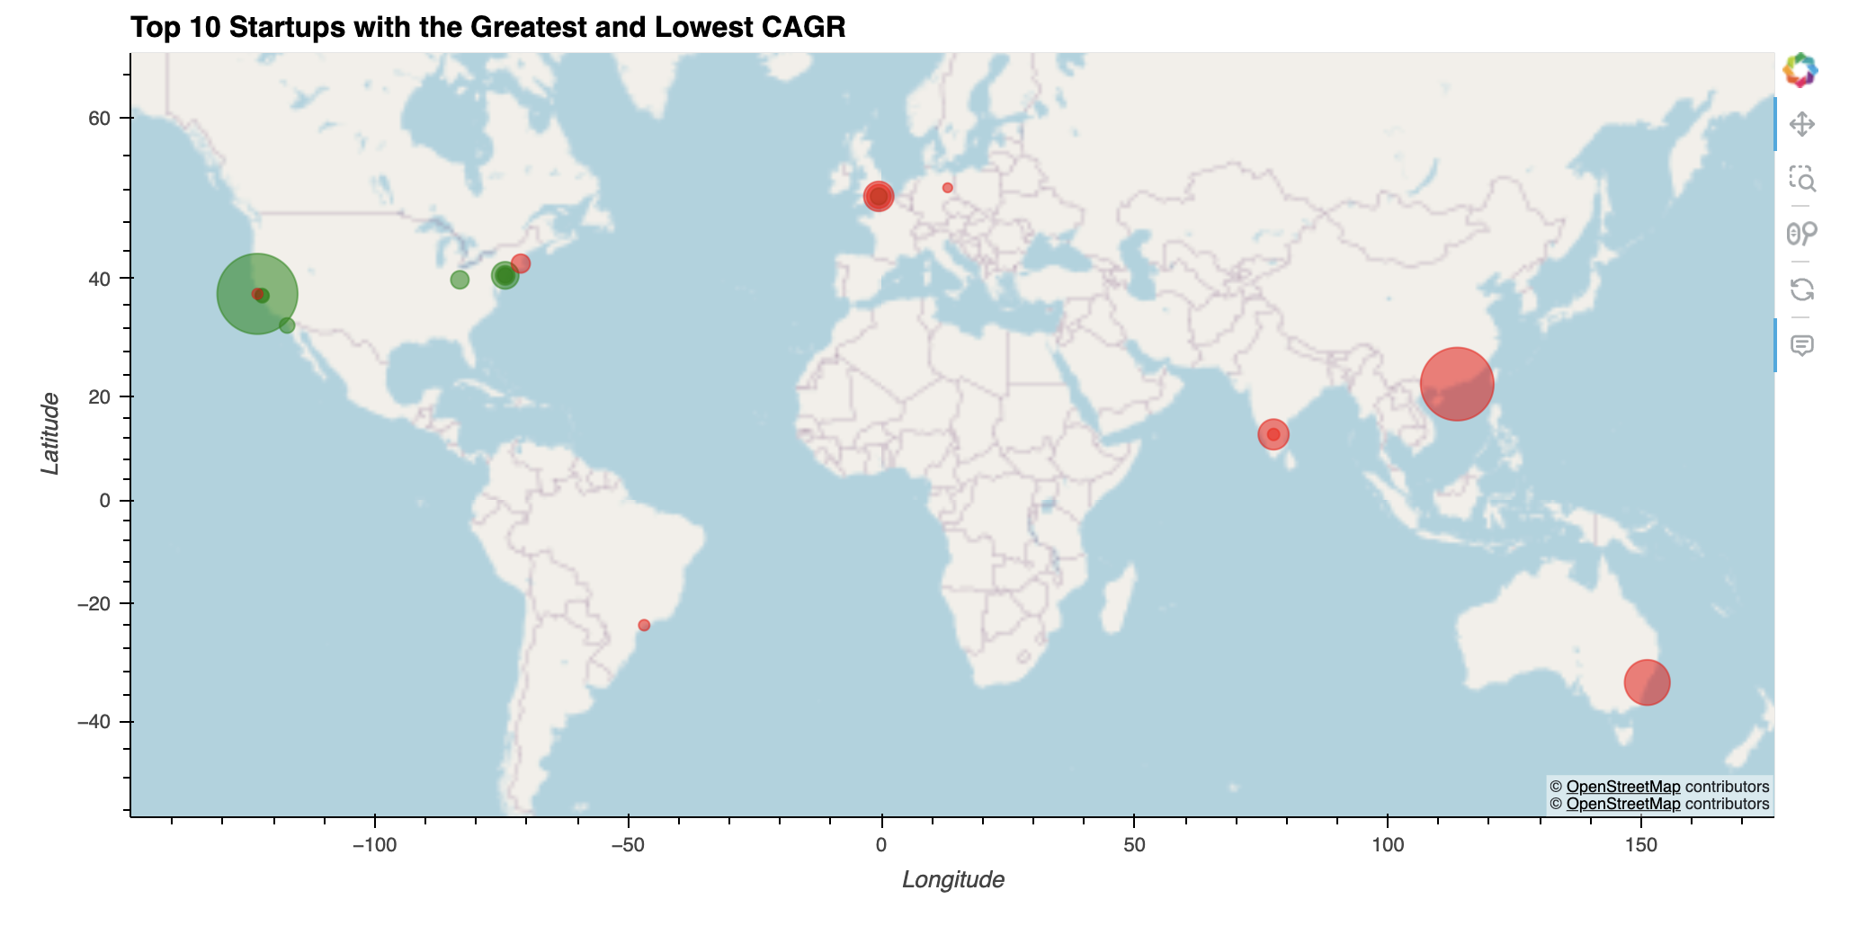
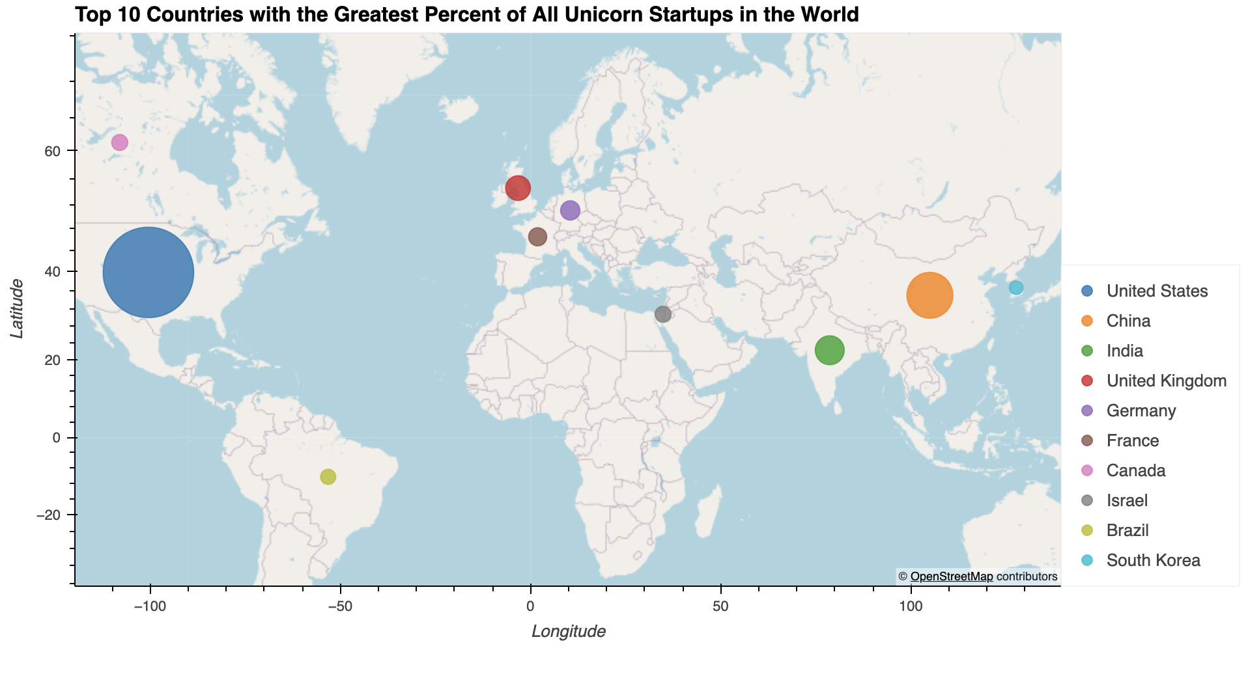
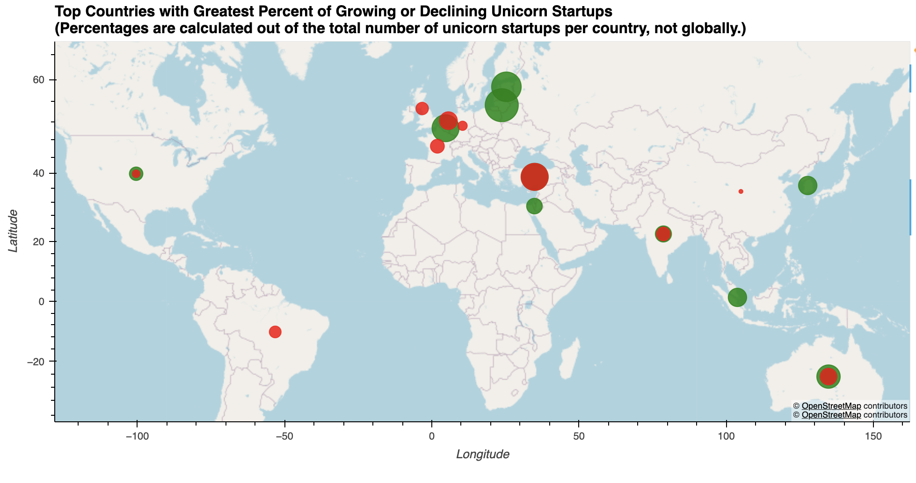
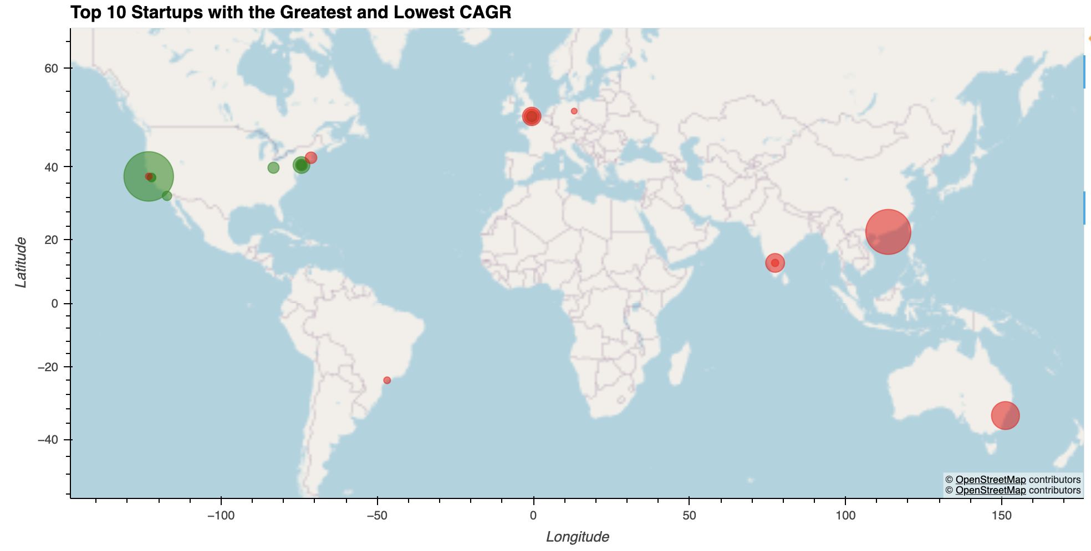

Slide 8
Data Set Sources:
CB Insights:
- https://www.cbinsights.com/research-unicorn-companies
Kaggle:
- https://www.kaggle.com/datasets/tahzeer/unicorn-startup-companies-july-2023
- https://www.kaggle.com/datasets/ramjasmaurya/unicorn-startups
sources

